Slide 1
Databases User Network Day
25th June 2015

Slide 2











































User Network Day
Notes:
Housekeeping – no planned fire drill
Toilets
Lunch and refreshments
Welcome
The reason we're here is to provide you with a service which supports your charitable objectives. You can see many of the charities we're working with on this slide behind - they carry out a wide range of activities.
From working with children with special needs, to counselling adults and helping people with mental health issues. From training and capacity building for voluntary groups, through to being a local voice for your beneficiaries, GMCVO and the Databases service are working with both small and larger organisations providing the systems to help you work smarter.
You work in a range of areas including: -
Special needs education
Mental health and wellbeing
Homelessness
Drug and alcohol rehabilitation
Health, skills and support
Young people, children, carers

Slide 3
Timetable
@gmcvodatabases
0930 Arrival
0945 Welcome and Introductions
0950 User Showcase – GHT (Samuel Clarke)
1000 Open Data (Steven Flower - Open Data MRC, and Mike Wild - MCC)
1100 Coffee/ Review User Clinic Questions
1115 Export Data- Demo
1130 Export Data- Exercises
1200 User Clinic and Lunch
Notes:
Introductions – name badges
Tick list

Slide 4
Vision
@gmcvodatabases
The long term vision for GMCVO Databases is that we will: -
Continue to support new and existing client organisations with excellent database services in the form of consultancy, system delivery and support.
Maintain expertise, be in demand, have an outstanding reputation and be a leader amongst our peers.
Generate a profit, grow at a challenging and manageable rate to allow GMCVO to carry out its charitable objectives
Notes:
On this slide behind me I have a vision for GMCVO Databases which I was asked to write shortly after I joined. I still think it holds true.
<quote>
There continues to be a real need for charities and voluntary groups to be supported in this area. We do this through providing technical solutions to everyday problems addressing challenges in communicating with stakeholders, recording case work, managing events or training and managing your volunteers.
It excites me to work with you and hear about the impact of your work and how a system can support you in achieving your aims. Ultimately its about people, not systems. But systems, such as databases are tools which we can use to help us work smarter by streamlining our processes.
If there's anything I've learnt so far working at GMCVO, it is that the voluntary, community and social enterprise sector is diverse. Many groups don't even know they're part of this sector, they just get on with doing their thing that makes a difference to their beneficiaries.
However, I believe you're here because you think your data is important to your organisation, because alongside your people (i.e. your staff and volunteers), your data is your most valuable asset to provide evidence for what you do.
Whether that is
how many people attended your training course,
who received your support
how many service users are from a particular demographic,
or how did this volunteer hear about us.
Data is key to how we design and improve our services.
So, well done for making today a priority.

Slide 5
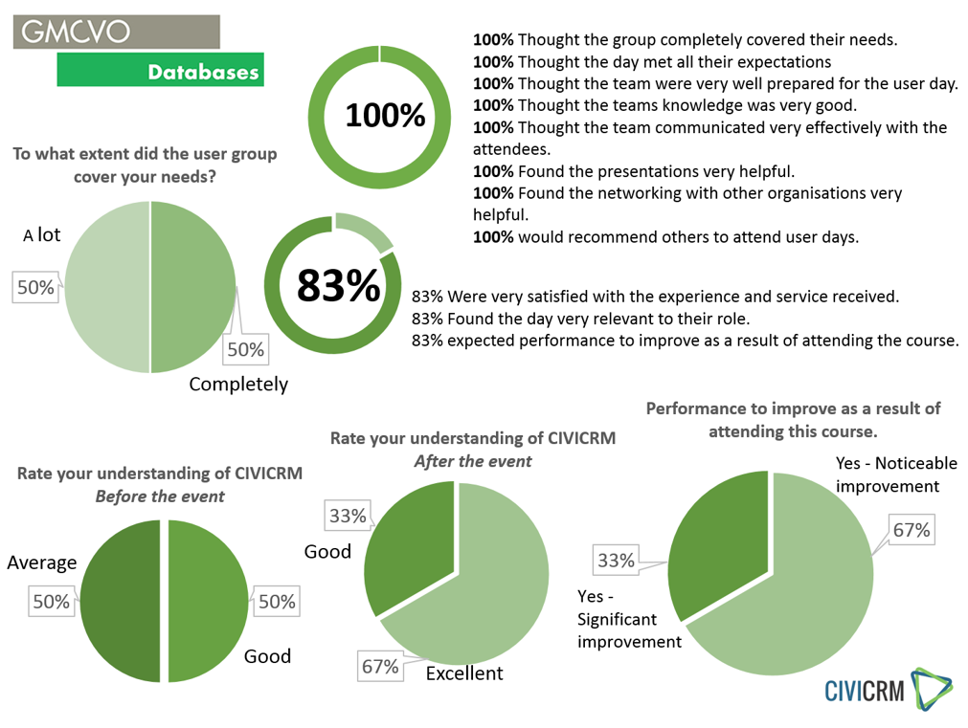
Feedback from last time...
@gmcvodatabases
Pheo’s slide here
Notes:
One of the reasons we have this networking day is to find out what you like and what you'd like to see change. This feedback slide and the comments we've received so far have been really encouraging, thanks for that. It means a lot to know that we’re appreciated!
Your feedback is important to us, please don’t leave here without completing a feedback form. We want to know what you think is missing either from what we cover today or our service as a whole. Ask us how we can support your processes better and perhaps we’ll already have an answer, but its really useful to start with a conversation so this is an ideal time to talk.
As we were organising this day, we also came across a number of clients who were unable to commit to a coming as the result of the full day so we are now considering running half day user groups in June and October. We’ll send out the details in good time.

Slide 6

What was the most useful part of the day?
“Learning about what the software can do”
“Managing events”
“Schedule reminder functions”
“How different parts of the CRM link together”
What changes could be made to improve future user groups?
“More frequent events”
“Focus on key areas in different meetings”
Any other comments about the St Thomas Centre?
“Great venue”
“Knowledgeable & helpful staff”
“Support was brilliant”
“Very nice lunch”
“Lovely venue”

Slide 7
Introduction
@gmcvodatabases
New services
  Copyrighting
  Google Ads Grants
Future meets - Thursdays
  22nd October 2015

Slide 8

www.ght.org.uk
Volunteers and CiviCRM
at George House Trust
To: Databases User Network
By: Samuel Clarke
Date: June 2015
Tel: 0161 274 4499 Email: info@ght.org.uk
77 Ardwick Green North, Manchester M12 6FX

Slide 9
Volunteering with Service Users
DBS Roles
  Custom fields for convictions data
  Criminal Record Declaration
  Automated Reminders
Peer Mentoring
  Guidance and support from mentor to mentee
  Meeting documented with form based on relationship
  Conditioned logic allows for targeted follow-up

Slide 10
Volunteering in the Office
Reception Meet and Greet
  Hours logged and reported as ‘cost saving’
  Volunteers take ownership of logging hours
  Report allows receptionist to cross check
Workshops, Courses and Events
  Volunteers can update availability
  Scheduled reminders via email and SMS
  SMS response confirmation

Slide 11
Exporting Data
Exporting lets you share data with external applications by providing a copy of data from CiviCRM in a standard comma separated value (CSV) format.
You can either export a predefined set of fields or create your own custom export mapping which can be saved for reuse.

Slide 12
CiviCRM's export functionality is available:
in any of the search tools
(quick search/ advanced search/ search builder)
when viewing contacts in a group
in component-based search results, where the resulting records reflect the component specific data rather than simply core contact data.
(contributions/ events/ memberships)

Slide 13
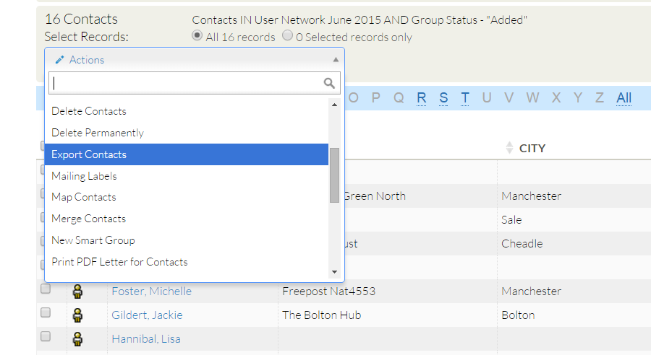
Export contact information:

Slide 14
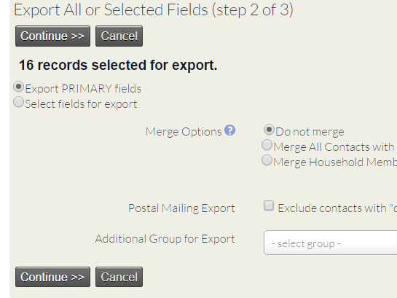
Primary Fields.
include all core contact fields with email, phone, and address data.
Select fields
Include custom data relating to the type being searched.

Slide 15
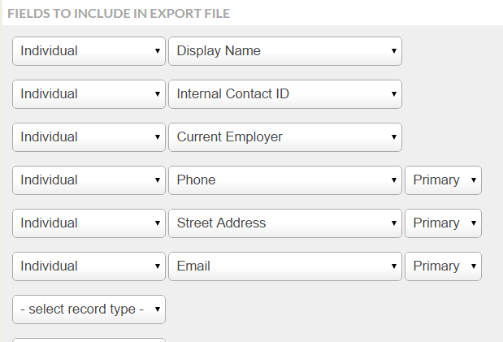
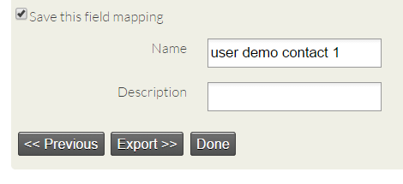
Mapping
Save mapping

Slide 16
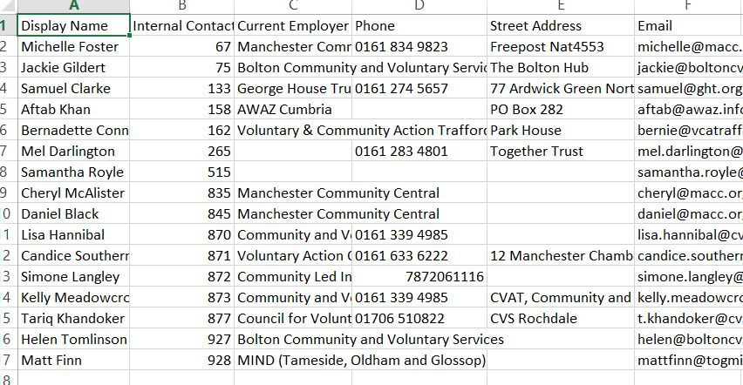
CSV export

Slide 17
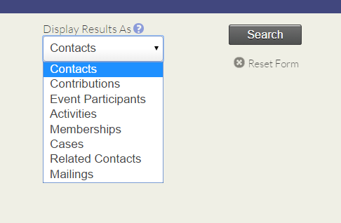
Advance search – display result as
Advanced Search returns your results as Contact records by default. However, you may want to get another record type instead.

Slide 18
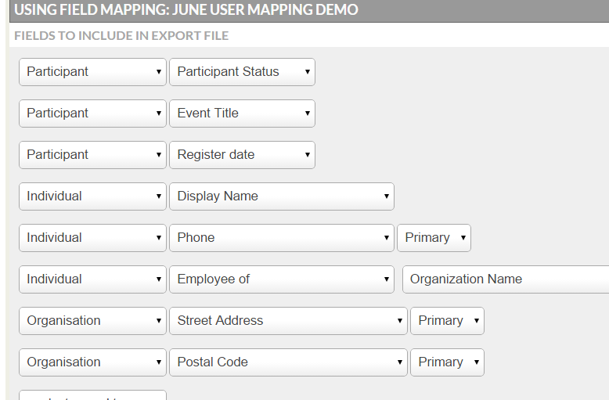
Event participant
Extra fields relating to participant data

Slide 19
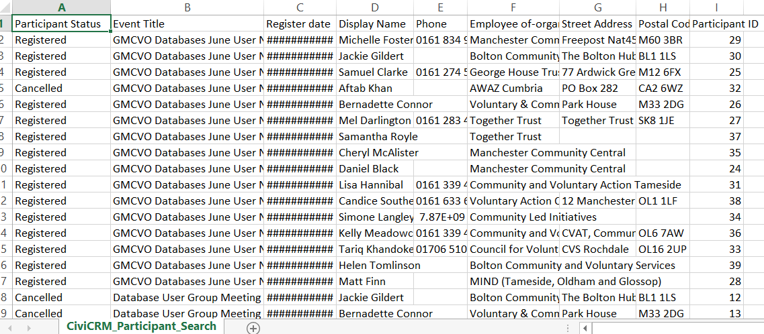
Participant Export CSV

Slide 20
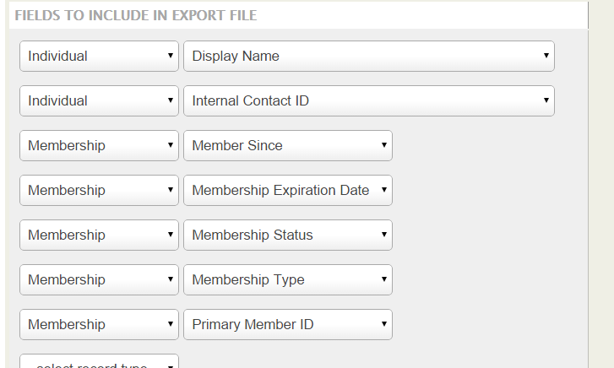
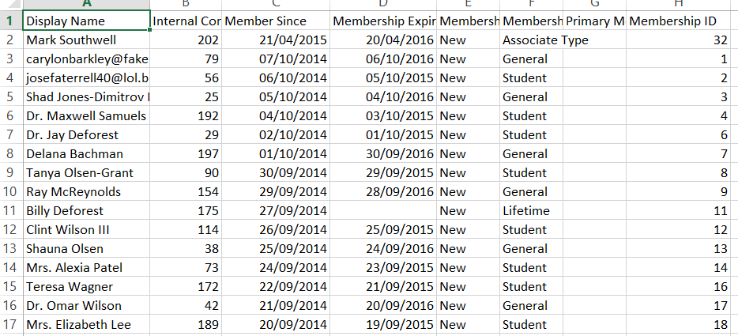
Membership
Extra membership fields

Slide 21
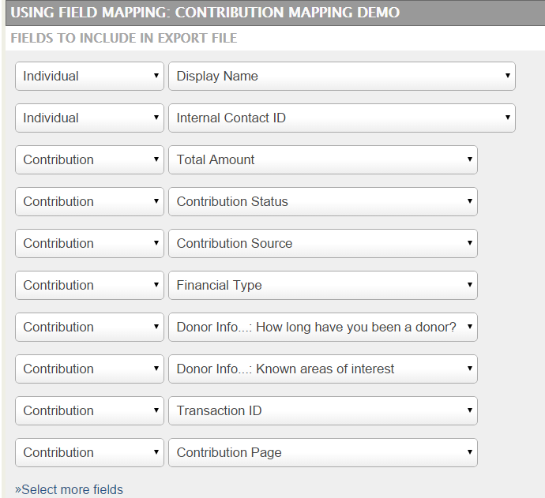
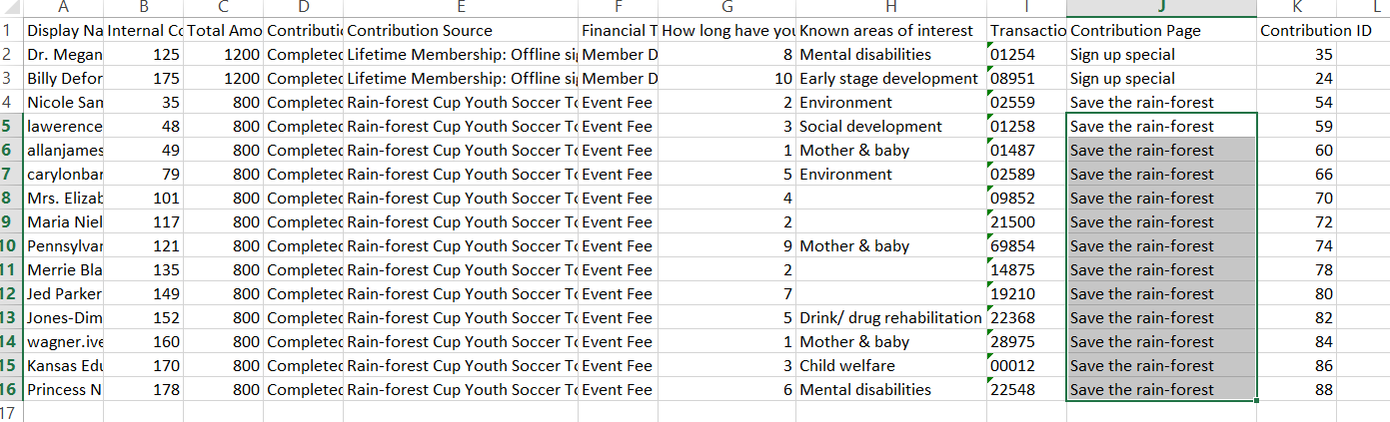
Contributions
Extra contribution
fields

Slide 22
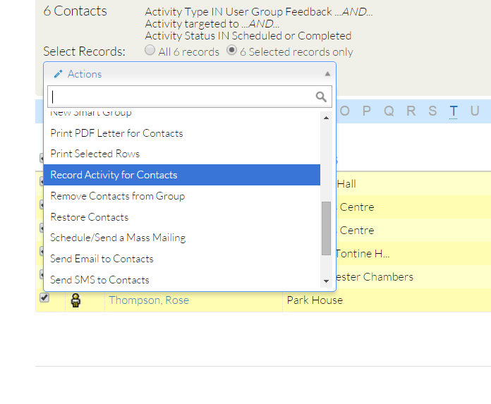
You will find in many cases after triggering an action, you can return to the search result list and trigger a follow up action,
Add to group
Add to event
Batch update via profile

Slide 23
Exercises
Using Advanced search and Display results as Contacts
Make a search and select a few records,
Export primary fields (take a look at the download at the information )
Select fields for export (create a mapping and export)
compare the two different types of information exported.

Slide 24
Exercise 2
Do another Advanced search but this time display results as Participants / Memberships
Select a few records
Create a simple mapping relating to Participants/ Memberships
Export.

Slide 25
Exercise 3
Do another Advance search this time display results as an Activity.
Select an activity type.
Make a search.
Select a few records
Create a mapping (with fields relating to the activity you have chosen)
Export.

Slide 27
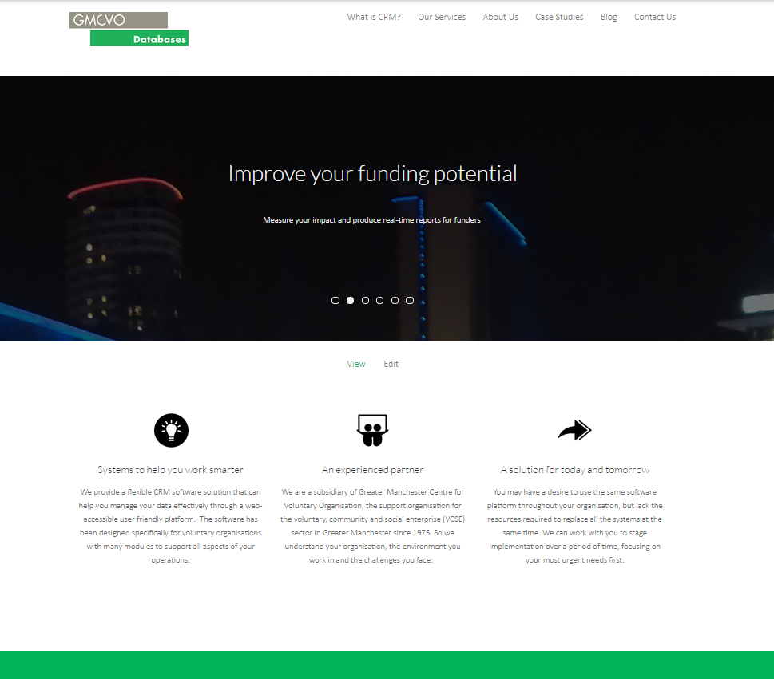

Slide 28
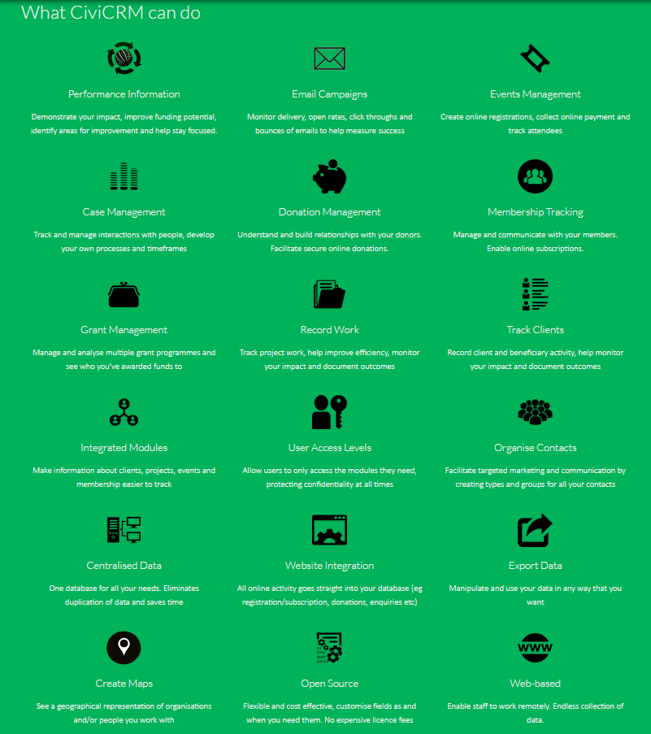

Slide 29


Slide 30
Thanks for coming!
@gmcvodatabases
Remember:
Future meets - Thursdays
  22nd October 2015
GMCVO Support
CiviCRM Meet ups
Online help
  Forums, forum.civicrm.org
  Documentation, book.civicrm.org

Slide 31

Thank-you for coming
Feedback appreciated
Notes:
Thanks for your attention
Handout forms

